Slide 1
November 8 – 11, 2022

Slide 2


Slide 3
ASP.NET Core Internal Architecture
Thien Nguyen

Slide 4
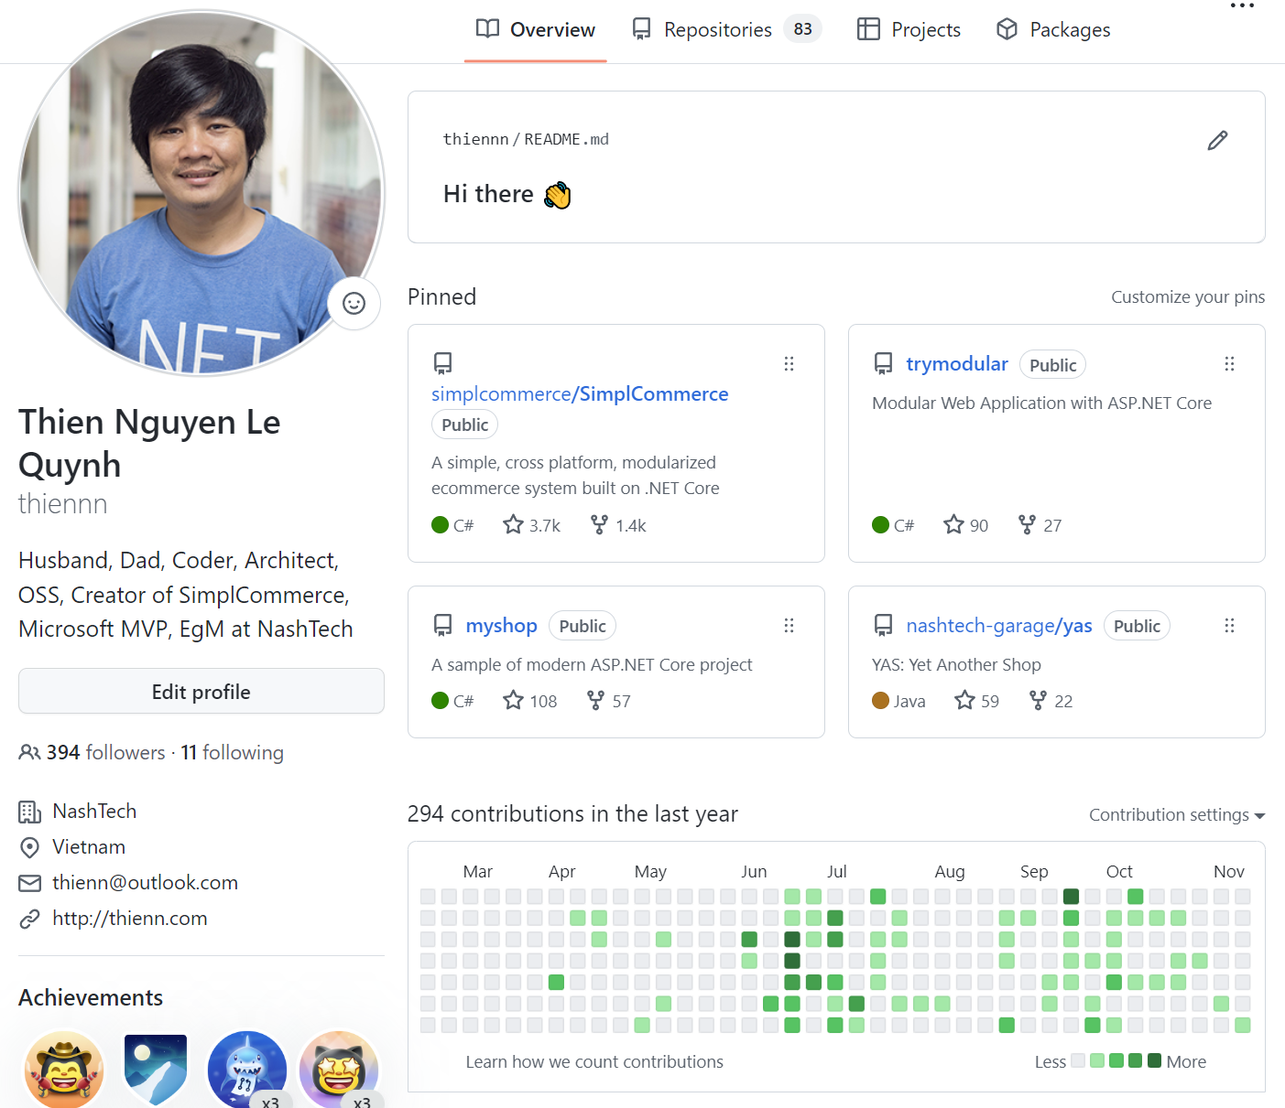
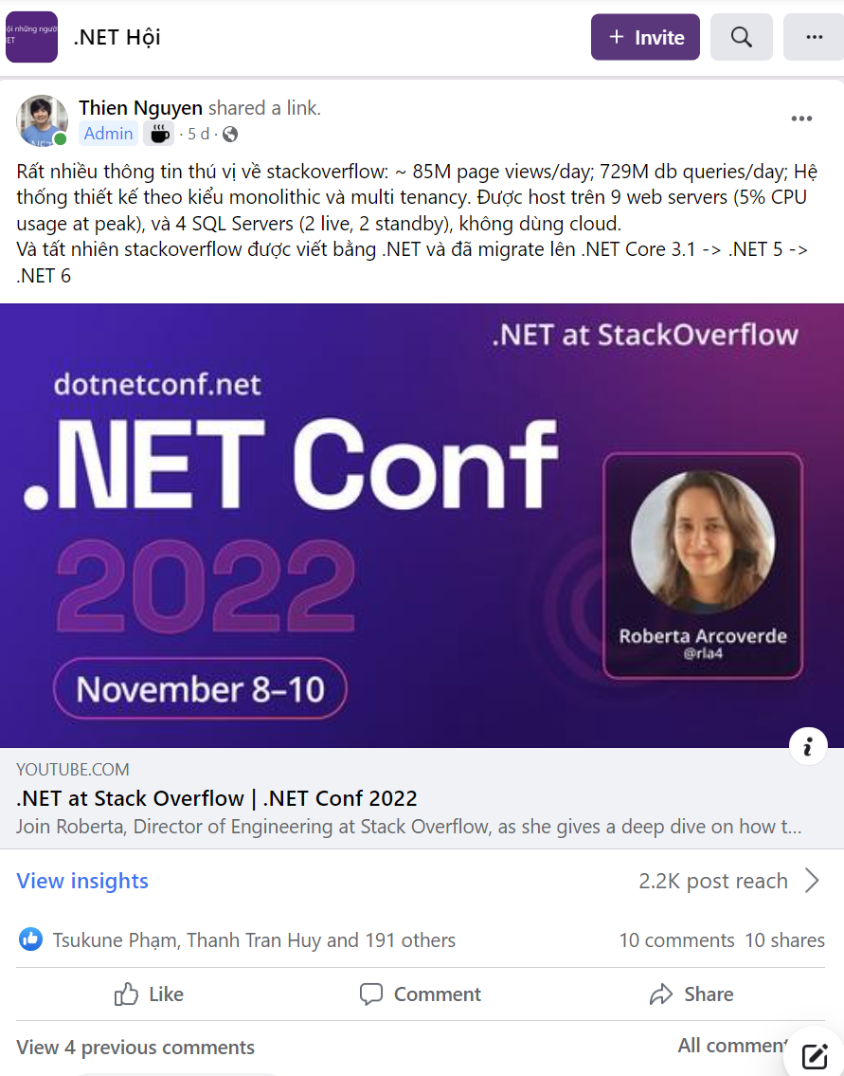
About me
https://github.com/thiennn
https://www.facebook.com/groups/dotnetvn

Slide 5






ASP.NET Core History
On November 12, 2014, Microsoft announced .NET Core (link)
In the early days (2014 – 2015), ASP.NET Core was called ASP.NET vNext then ASP.NET 5: project.json, dnx, dnu, dnvm
From ASP.NET 5 RC2 transitioned to the new tool: .csproj, dotnet cli
ASP.NET Core 1.0 released on 27-Jun-2016
Scott Guthrie
David Fowler
Damian Edwards
Daniel Roth
Steve Sanderson
Scott Hunter

Slide 6
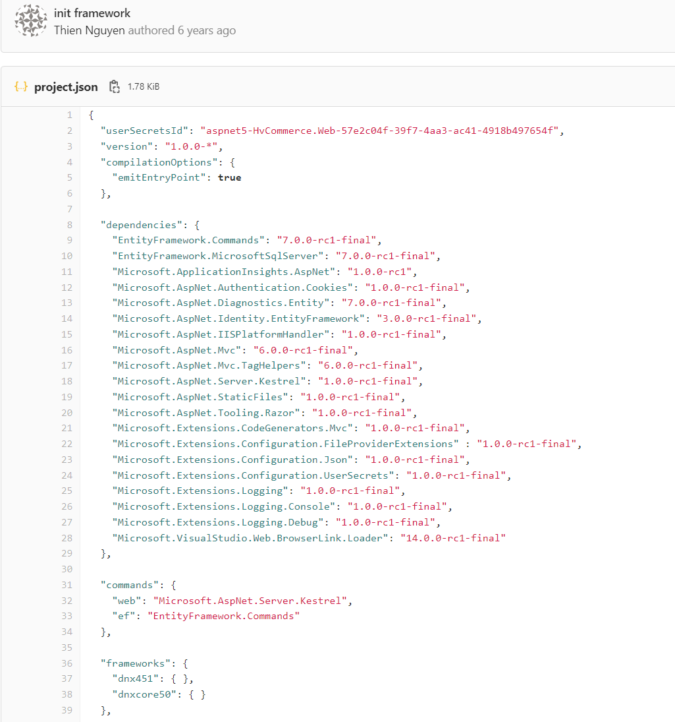
SimplCommerce’s journey
First commit on 13-Jan-2016
It used ASP.NET 5 RC1 at this time
https://github.com/simplcommerce/SimplCommerce/commit/fef814ef53241baa56853cc1e56165dbefc6ba34

Slide 7



ASP.NET Core 1.0
Web
Forms
MVC
Web API
ASP.NET Core MVC
ASP.NET 4.6
ASP.NET Core 1.0
(Server, Middleware, DI, Configuration, Logging)
.NET Framework
.NET Core
Platform for .NET applications on Windows
Cross-platform, modular libraries & runtime optimized for server and cloud workloads

Slide 8
Project Houndini (From ASP.NET Core 2)
Endpoint Routing is our first “big bet” in the framework layer
Makes it easy to interop between middleware and high-level frameworks
Uniform way our frameworks are configured
Server
Middleware
Routing
Controllers
(MVC)
Pages
SignalR
gRPC
Blazor Server

Slide 9
ASP.NET Core: Unified web framework
Extensions
Web UI
Services
Extensions
Web UI
Services
MVC
Razor Pages
SPA
Blazor
HTTP APIs
SignalR
gRPC
Logging
Configuration
Middleware
Middleware
Routing
Security
Localization
Caching
Options
Compression
Session
Health Checks
…
File Providers
Servers
Worker
Services
Servers
Worker
Services
Kestrel
IIS
HTTP.sys
Dependency Injection
Hosting
Hosting
Notes:
ASP.NET Core is our modern Web framework for .NET. It includes everything you need to build beautiful Web UIs and powerful back-end APIs & services. Unlike other development platforms that require you to piece together a Web app from multiple frameworks, ASP.NET Core provides a complete and cohesive Web development solution.
For web UI, you can use MVC and Razor pages to build dynamic server-rendered UI, you can integrate with popular JavaScript frameworks, and you can build rich interactive Web UI completely in C# using Blazor.
For services, you can build standards-based HTTP APIs, real-time services with SignalR, or high-performance back-end services with gRPC.
ASP.NET Core includes a rich array of built-in middleware for handling all of your cross-cutting concerns like routing, security, localization, caching, compression, and much more.
ASP.NET Core also integrates with cloud-ready .NET platform extensions for handling concerns like logging, configuration, dependency injection, and others.
You can then host your ASP.NET Core app using a variety of different HTTP servers, including Kestrel, our built-in ultra fast and cross-platform web server.
No matter what sort of web app you're trying to build, ASP.NET Core has everything you need so you can focus on your app and stay productive.

Slide 10
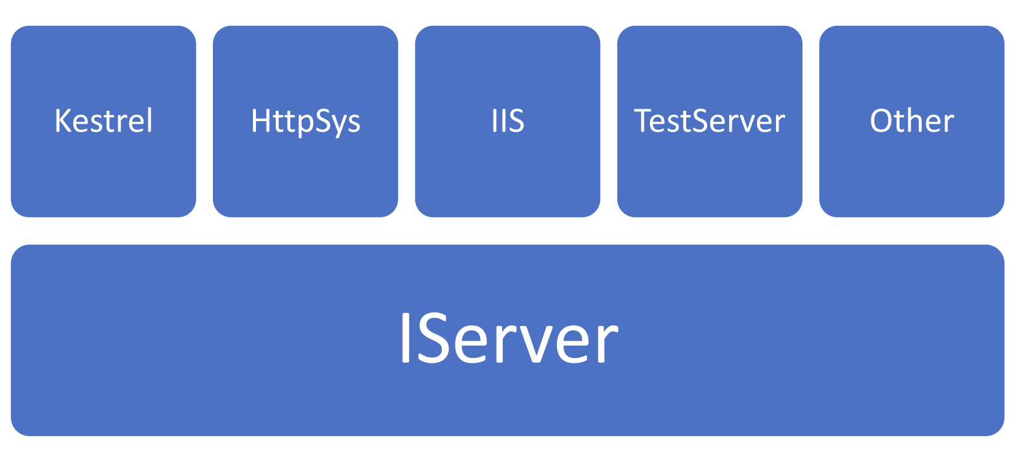
Server Architecture

Slide 11
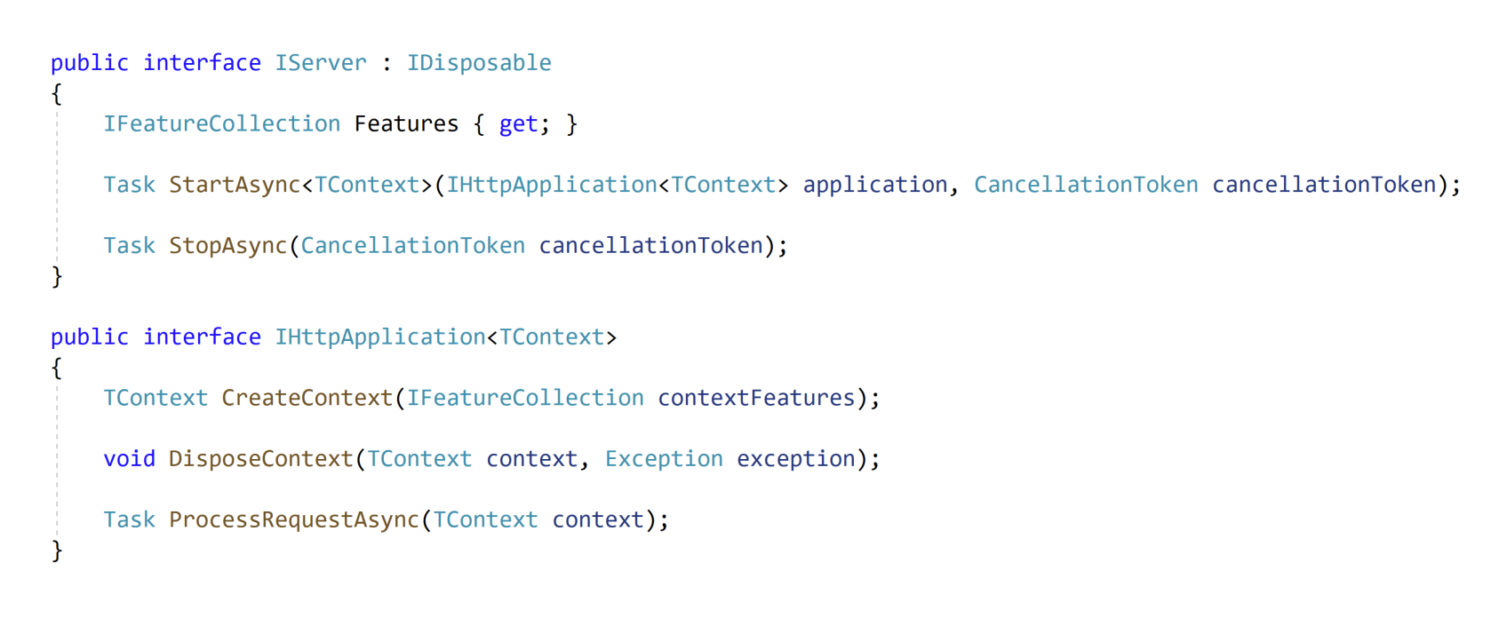
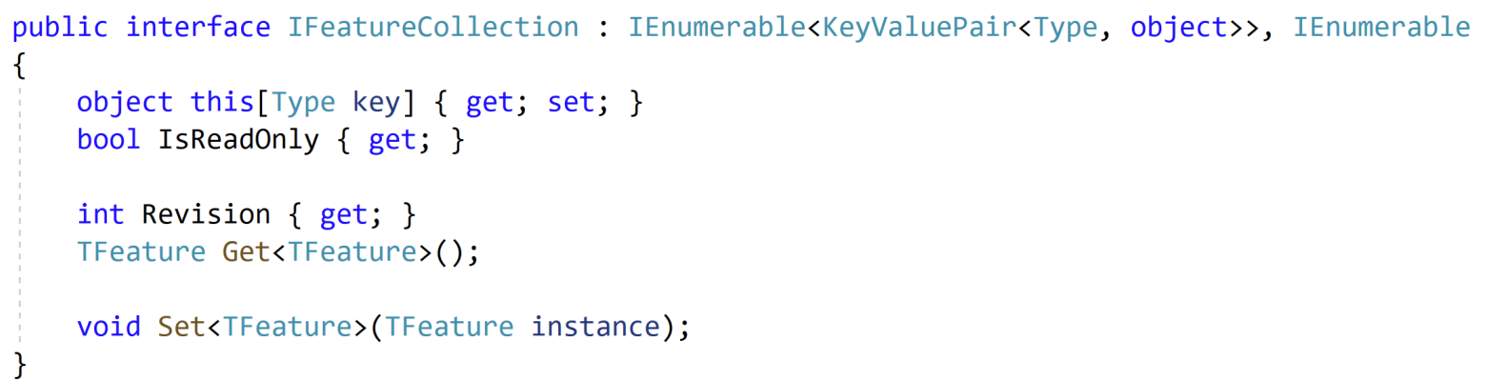

Slide 12
Request Features in ASP.NET Core
Each feature interface provides a granular subset of the functionality exposed by HttpContext
They can be added, modified, wrapped, replaced, or even removed by the server or middleware as the request is processed without having to re-implement the entire HttpContext
ASP.NET Core defines several common HTTP feature interfaces in Microsoft.AspNetCore.Http.Features
You can also define your own feature
https://docs.microsoft.com/en-us/aspnet/core/fundamentals/request-features
https://github.com/dotnet/aspnetcore/tree/v7.0.0/src/Http/Http.Features/src
https://khalidabuhakmeh.com/request-features-aspnet-core-3

Slide 13
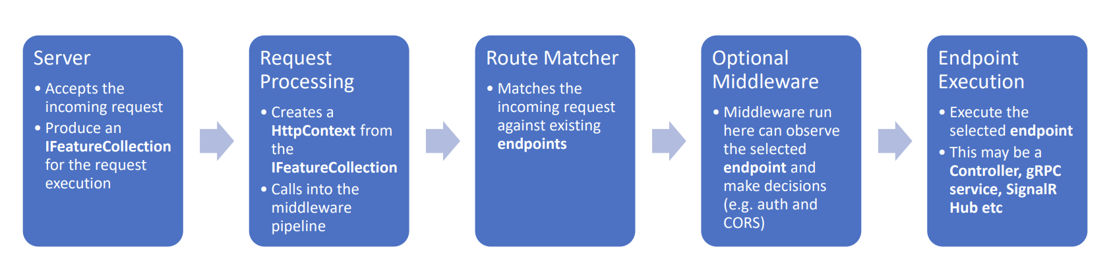
Anatomy of a request

Slide 14
Request Processing
Creates a HttpContext from the IFeatureCollection
The HttpContext wraps the server’s IFeatureCollection and exposes a convenience layer on top
Application code is written against this layer and is server agnostic
Everything is asynchronous!

Slide 15
HttpContext
HttpContext encapsulates all HTTP-specific information about an individual HTTP request.
HttpContext isn't thread-safe
https://github.com/dotnet/aspnetcore/blob/v7.0.0/src/Http/Http/src/DefaultHttpContext.cs
https://docs.microsoft.com/en-us/aspnet/core/fundamentals/http-context
https://github.com/davidfowl/AspNetCoreDiagnosticScenarios/blob/master/AspNetCoreGuidance.md

Slide 16
Minimal Hosting model (from ASP.NET Core 6)
The endpoint routing middleware wraps the entire middleware pipeline
var builder = WebApplication.CreateBuilder(args);
var app = builder.Build();
app.UserRouting
app.MapGet("/", () => "Hello World!");
App.UseEndpoint()
app.Run();
WebApplicationBuilder
Initialize the dependency injection, logging and configuration systems
WebApplication
Configure the HTTP pipeline, and routes
Run the application

Slide 17
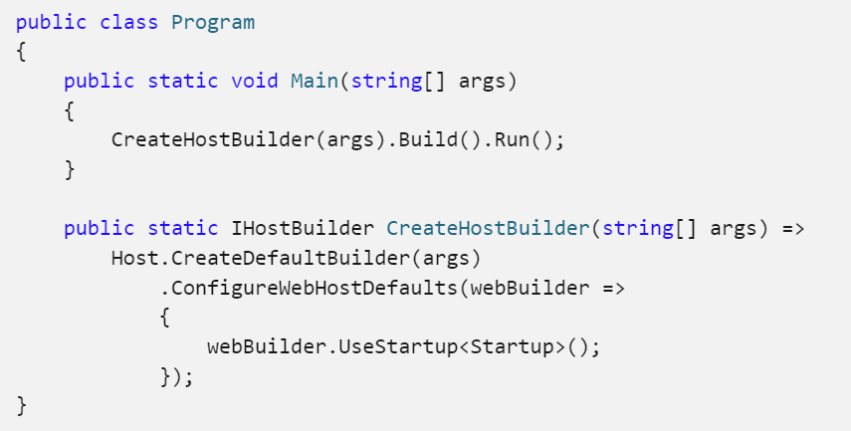
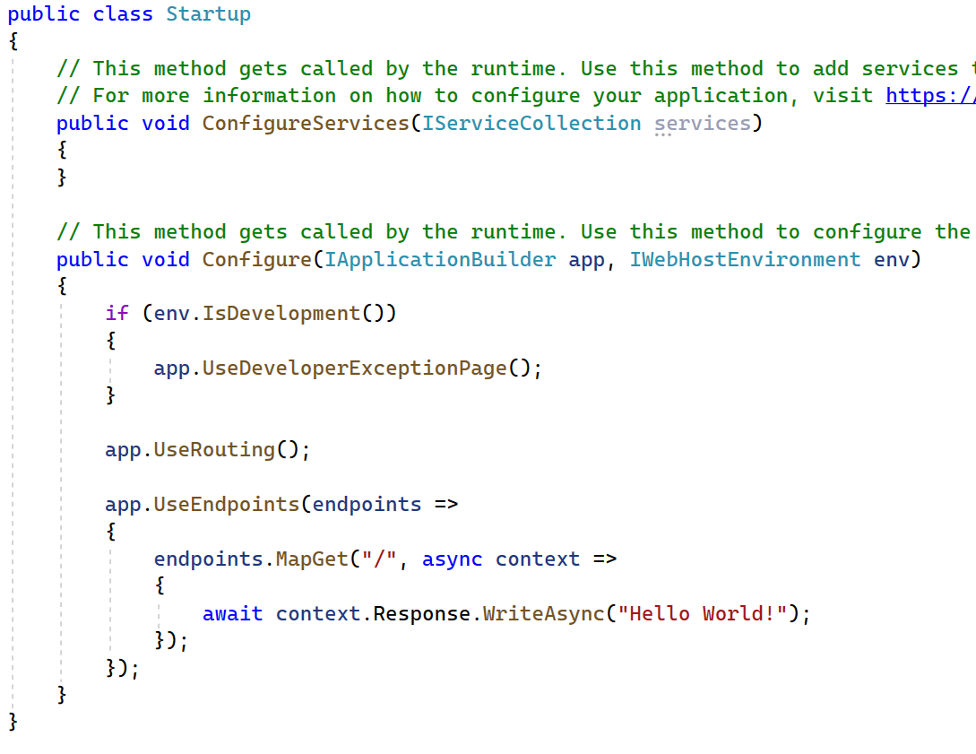
Do I need to migrate to Minimal Hosting model?
Should but not mandatory
Using Startup and the Generic Host used by the ASP.NET Core 3.1 and 5.0 templates is fully supported
WebApplication are just wrappers around the generic host introduced in .NET Core 3.0

Slide 18
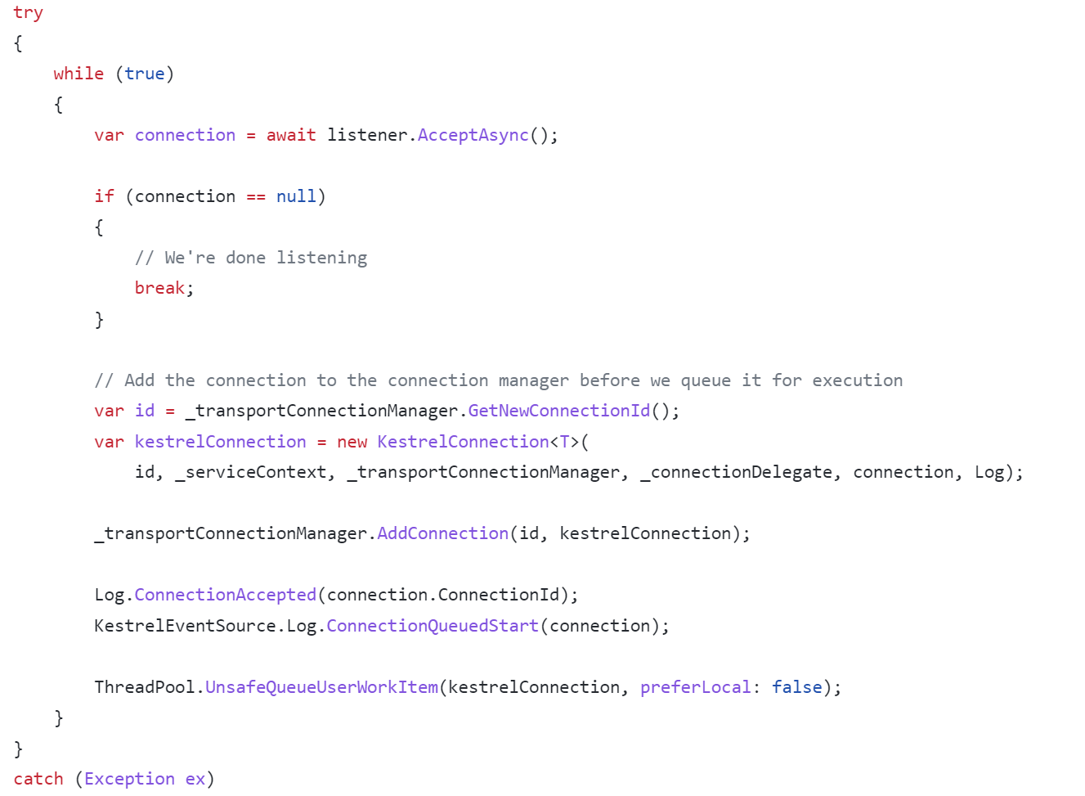
No Request Queue
The request queue in ASP.NET is designed to prevent thread pool starvation
https://referencesource.microsoft.com/#System.Web/RequestQueue.cs,8
https://github.com/dotnet/aspnetcore/blob/a450cb69b5/src/Servers/Kestrel/Core/src/Internal/ConnectionDispatcher.cs

Slide 19
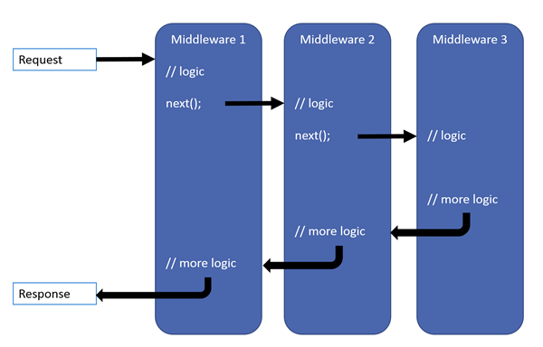
Middleware

Slide 20
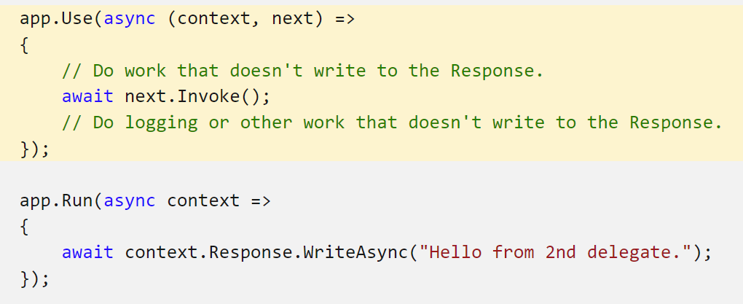
In-line middleware

Slide 21
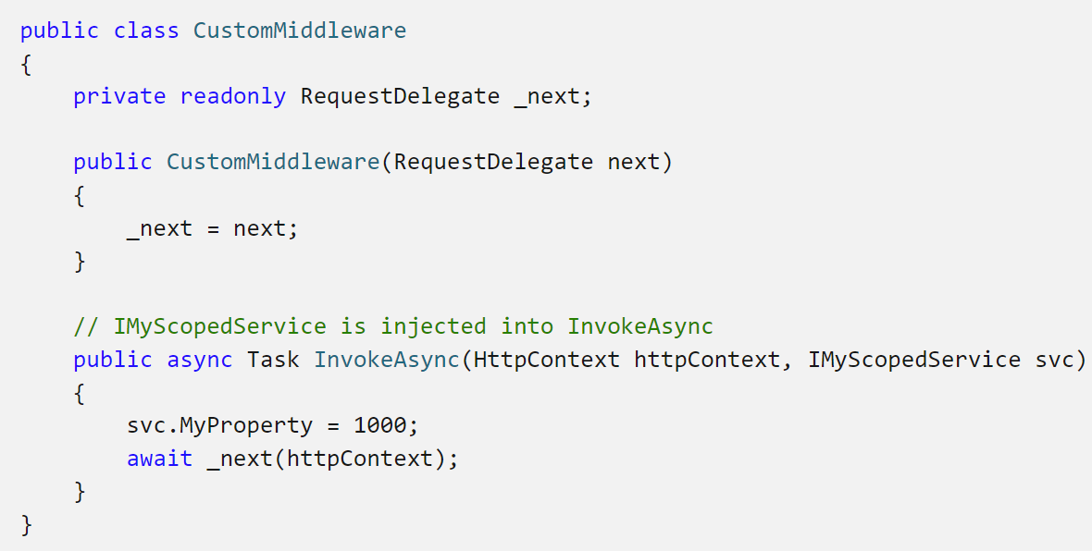
Convention-based middleware
The middleware class must include:
A public constructor with a parameter of type RequestDelegate.
A public method named Invoke or InvokeAsync. This method must:
Return a Task.
Accept a first parameter of type HttpContext.
Additional parameters for the constructor and Invoke/InvokeAsync are populated by dependency injection (DI).
app.UseMiddleware<CustomMiddleware>();
Note: Convention-based middleware is constructed at app startup and it is singleton

Slide 22
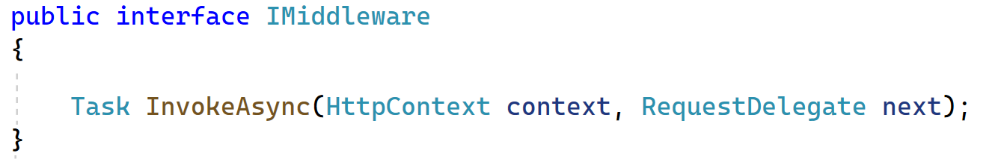
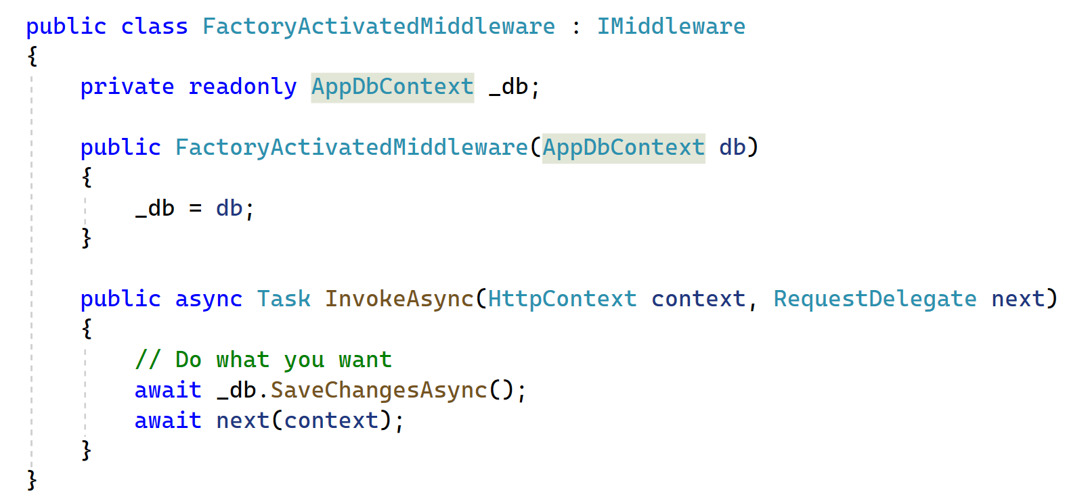
Factory-based middleware
Benefits:
Activation per client request (injection of scoped services)
Strong typing of middleware

Slide 23
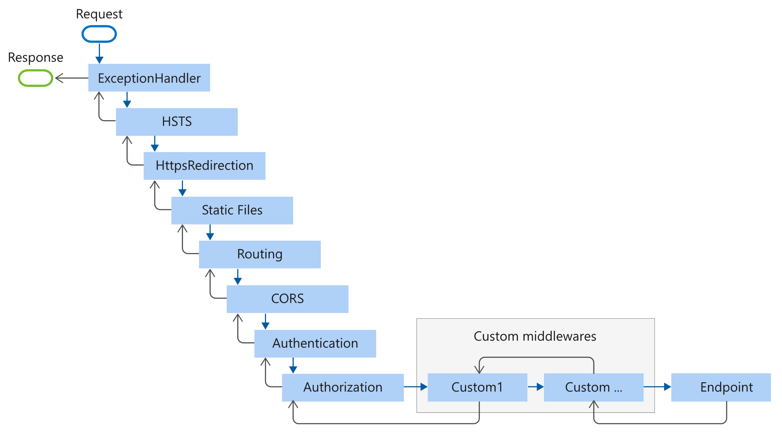
Middleware order

Slide 24
Routing
Routing is responsible for matching incoming HTTP requests and dispatching those requests to the app's executable endpoints
Routing uses a pair of middleware, registered by UseRouting and UseEndpoints:
UseRouting adds route matching to the middleware pipeline. This middleware looks at the set of endpoints defined in the app, and selects the best match based on the request.
UseEndpoints adds endpoint execution to the middleware pipeline. It runs the delegate associated with the selected endpoint.

Slide 25
Dependency Injection
ASP.NET Core is designed to support dependency injection
Transient: Transient lifetime services are created each time they're requested from the service container.
Scoped: For web applications, a scoped lifetime indicates that services are created once per client request. For other scenarios you are responsible to create and dispose scope, if not it will become singleton (begin scoped → end scoped)
Singleton: Singleton lifetime services are created either:
The first time they're requested.
By the developer, when providing an implementation instance directly to the container. This approach is rarely needed.
TryAddTransient, TryAddScoped, TryAddSingleton: add a service to the collection if the service type hasn't already been registered.

Slide 26
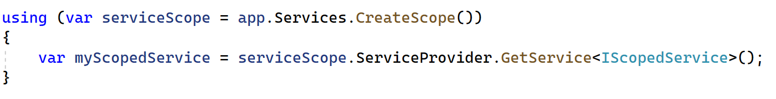
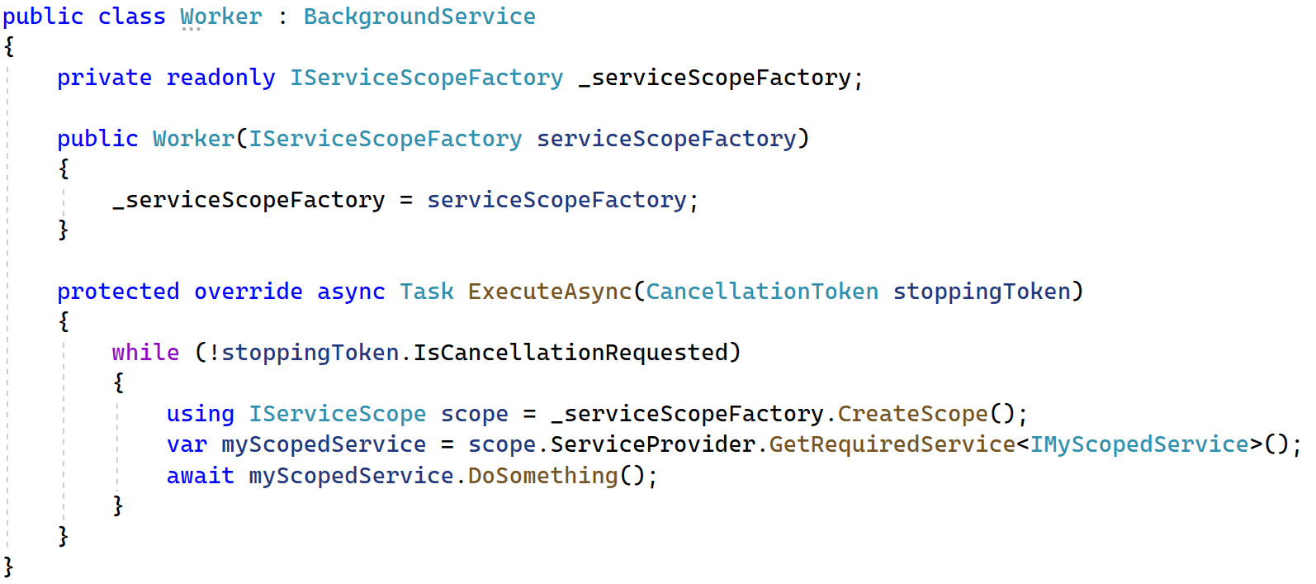
Create scope

Slide 27
Exception Handling
Normally don’t write your own Exception Handling middleware. Use existing one
Don’t try catch exception if you don’t actually handle them
Don’t swallow exceptions
Throw vs throw ex vs throw new Exception
https://docs.microsoft.com/en-us/aspnet/core/fundamentals/error-handling
https://docs.microsoft.com/en-us/aspnet/core/web-api/handle-errors
https://andrewlock.net/creating-a-custom-error-handler-middleware-function/
https://github.com/dotnet/aspnetcore/blob/main/src/Middleware/Diagnostics/src/ExceptionHandler/ExceptionHandlerMiddleware.cs

Slide 28
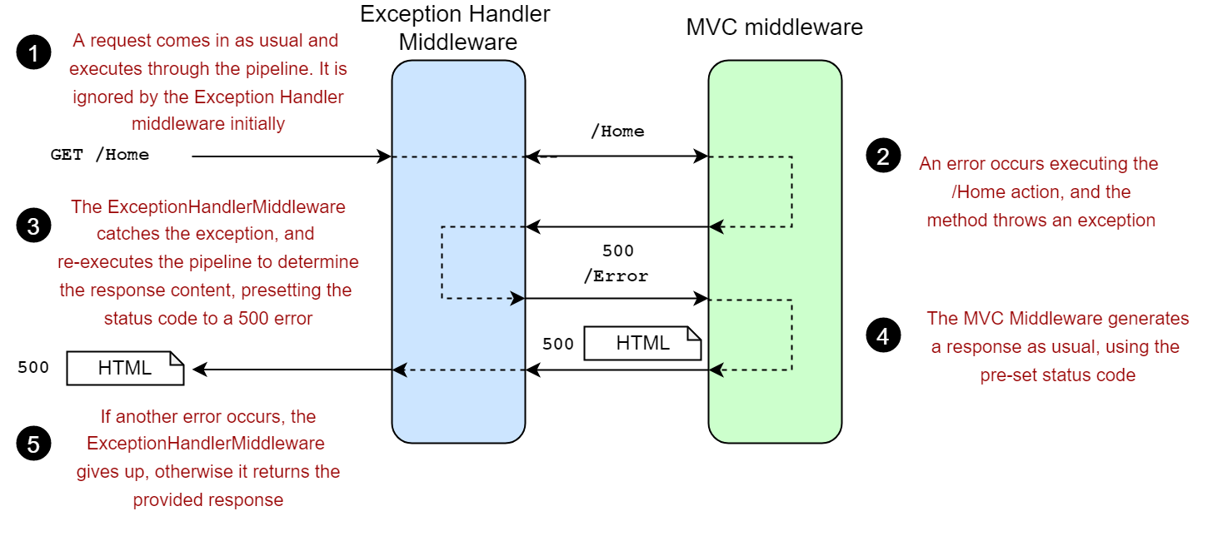
Exception Handler Middleware
https://andrewlock.net/creating-a-custom-error-handler-middleware-function/

Slide 29



Thanks for joining!
https://www.facebook.com/devcafevn https://www.youtube.com/c/devcafevn

